Slide 1
C# for test automation
Unit testing
Module 6

Slide 2
Agenda
Unit testing in C#
Levels of testing. L0-L3
C# Unit test frameworks
Unit test tools in Visual Studio
TDD concept. TDD levels
Test attributes, Assert class
Shouldly
Practice 1. The first unit test
Coffee break
Code coverage
Practice 2. Currency converter
Coffee break
Dependency injection
Test doubles
Stubs
Practice 3. Stub implementation
17. Lunch
Mocks
Practice 4. Mock's implementation

Slide 3
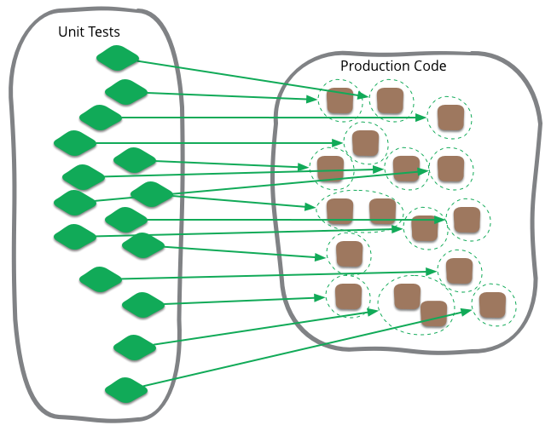
Unit testing In C#
DEFINITION
https://martinfowler.com/bliki/UnitTest.html
Notes:
UNIT TESTING is a type of software testing where individual units or components of a software are tested. The purpose is to validate that each unit of the software code performs as expected.
Unit Testing is done during the development (coding phase) of an application by the developers. Unit Tests isolate a section of code and verify its correctness.
A unit may be an individual function, method, procedure, module, or object.
So there's some common elements, but there are also differences. One difference is what people consider to be a unit. Object-oriented design tends to treat a class as the unit, procedural or functional approaches might consider a single function as a unit. But really it's a situational thing - the team decides what makes sense to be a unit for the purposes of their understanding of the system and its testing. Although I start with the notion of the unit being a class, I often take a bunch of closely related classes and treat them as a single unit. Rarely I might take a subset of methods in a class as a unit. However you define it doesn't really matter. (https://martinfowler.com/bliki/UnitTest.html)
)

Slide 4
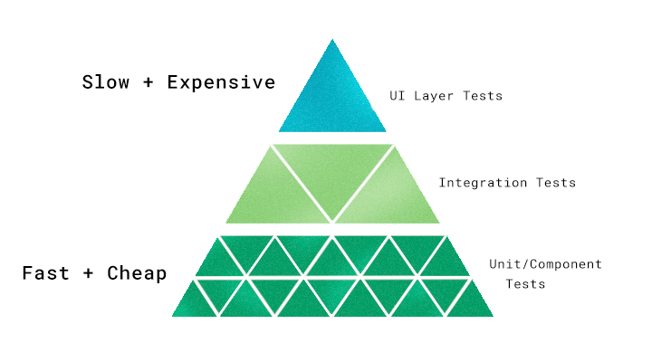
Unit testing In C#
LEVELS OF TESTING
Notes:
Unit or component tests (shown here at the bottom of our pyramid) are inexpensive and fast to perform.
Rely heavily on these. Only once you’ve exhausted what these tests can do should you move on to more expensive tests (in both time and resources), such as integration tests, and UI layer tests.

Slide 5
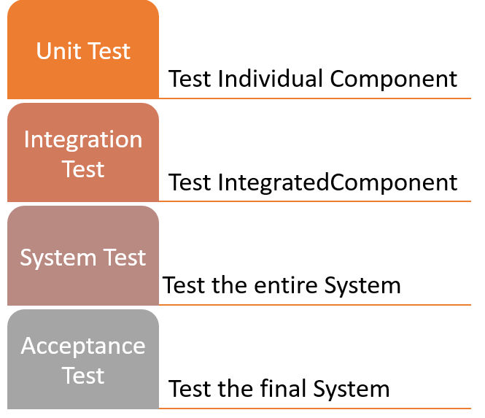
Unit testing In C#
LEVELS OF TESTING
L0 test is a classic Unit Test. It exercises an API. It has no dependencies on the product being installed. It has no state other than what’s in the test.
L1 is like a Unit Test, except it can rely on, for example database being in the environment.
L2 test is written against a fully deployed instance, but with some key things mocked out. The mocking is done to simplify testing and eliminate fragility.
L3 test is an end-to-end functional test against a production instance. You might call it “Testing in Production”. Many of these are UI automation.
Notes:
There are mainly four Levels of Testing in software testing :
Unit Testing : checks if software components are fulfilling functionalities or not.
Integration Testing : checks the data flow from one module to other modules.
System Testing : evaluates both functional and non-functional needs for the testing.
Acceptance Testing : checks the requirements of a specification or contract are met as per its delivery.
1) Unit testing:
A Unit is a smallest testable portion of system or application which can be compiled, liked, loaded, and executed. This kind of testing helps to test each module separately.
The aim is to test each part of the software by separating it. It checks that component are fulfilling functionalities or not. This kind of testing is performed by developers.
2) Integration testing:
Integration means combining. For Example, In this testing phase, different software modules are combined and tested as a group to make sure that integrated system is ready for system testing.
Integrating testing checks the data flow from one module to other modules. This kind of testing is performed by testers.
3) System testing:
System testing is performed on a complete, integrated system. It allows checking system's compliance as per the requirements. It tests the overall interaction of components. It involves load, performance, reliability and security testing.
System testing most often the final test to verify that the system meets the specification. It evaluates both functional and non-functional need for the testing.
4) Acceptance testing:
Acceptance testing is a test conducted to find if the requirements of a specification or contract are met as per its delivery. Acceptance testing is basically done by the user or customer. However, other stockholders can be involved in this process.
L0 – An L0 test is a classic Unit Test. It exercises an API. It has no dependencies on the product being installed. It has no state other than what’s in the test.
L1 – An L1 is like a Unit Test, except it can rely on SQL Server being in the environment. Our product is very SQL Server dependent and, in my opinion, trying to mock SQL is unwise/impractical for the depth of dependency that we have. Also, of course, a bunch of our code is in SQLServer stored procs and we need to test that too.
L2 – An L2 test is written against a fully deployed TFS/Team Services “instance” but with some key things mocked out. The mocking is done to simplify testing and eliminate fragility. The best example is that we mock out authentication so we don’t have to deal with creating test identities, managing secrets, etc. Some L2s are UI automation but only a smallish percentage.
L3 – An L3 test is an end-to-end functional test against a production TFS/VSTS instance. You might call it “Testing in Production” Many of these are UI automation. The truth is that we’ve only recently gotten to the point that we’re ready for rolling out L3 tests and we only have a few. Over time, the count will grow some but it will always be a tiny fraction of L0 and L1.

Slide 6
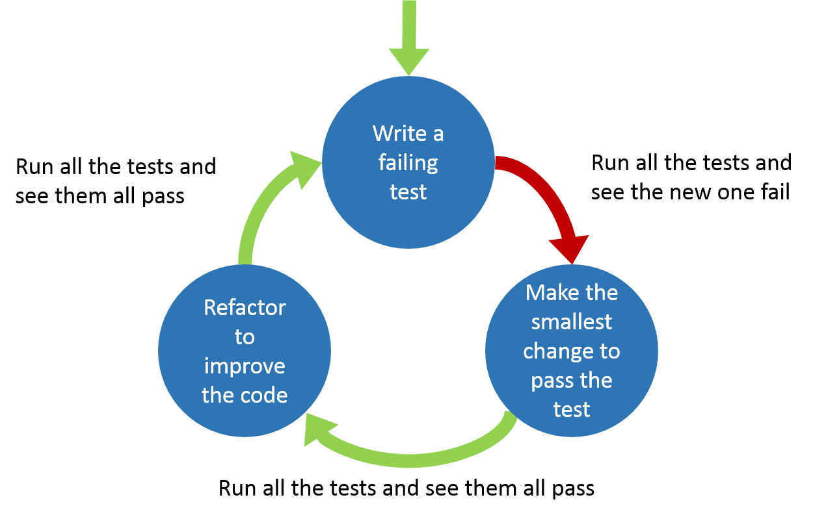
Test Driven Development
TDD concept
Test Driven Development (TDD) is software development approach in which test cases are developed to specify and validate what the code will do. In simple terms, test cases for each functionality are created and tested first and if the test fails then the new code is written in order to pass the test and making code simple and bug-free.
Notes:
Test-Driven Development starts with designing and developing tests for every small functionality of an application. TDD instructs developers to write new code only if an automated test has failed. This avoids duplication of code. The full form of TDD is Test-driven development.
The simple concept of TDD is to write and correct the failed tests before writing new code (before development). This helps to avoid duplication of code as we write a small amount of code at a time in order to pass tests. (Tests are nothing but requirement conditions that we need to test to fulfill them).

Slide 7
Test Driven Development
TDD LEVELS
There are two levels of TDD
Acceptance TDD (ATDD): With ATDD you write a single acceptance test. This test fulfills the requirement of the specification or satisfies the behavior of the system. After that write just enough production/functionality code to fulfill that acceptance test. Acceptance test focuses on the overall behavior of the system. ATDD also was known as Behaviour Driven Development (BDD).
Developer TDD: With Developer TDD you write single developer test i.e. unit test and then just enough production code to fulfill that test. The unit test focuses on every small functionality of the system. Developer TDD is simply called as TDD.
Notes:
The main goal of ATDD and TDD is to specify detailed, executable requirements for your solution on a just in time (JIT) basis. JIT means taking only those requirements in consideration that are needed in the system. So increase efficiency.

Slide 8



Unit testing In C#
C# UNIT TEST FRAMEWORKS
Notes:
A test framework usually consists of two components:
A test library itself. It includes attributes, assertions, extendibility and customizations tools
A test runner. It recognizes attributes and uses these attributes to finds the tests, run them and report test results back. E.g. Test explorer window and dotnet test command line interface.
MSTest ships with Visual Studio, so you have it right out of the box, in your IDE, without doing anything.
2. Next up, I’ll talk about NUnit. Unit test frameworks have a history dating back almost 30 years, so they long predated .NET. NUnit started out as a port from Java’s JUnit, but the authors eventually redid it to be more C# idiomatic. So, the tool has the rich history of unit testing behind it, but with an appropriately C# flavor.
Because of its independent history, NUnit also has the distinction of interoperating nicely with other tools, such as non-Microsoft build platforms and custom test runners. On top of that, NUnit also has a reputation for fast testing running, and it has some nice additional features as well, including test annotations allowing easy specification of multiple inputs to a given test.
The main downside here is that it doesn’t integrate into Visual Studio the way that MSTest does. Using it means doing extra work, and installing extra tools, regardless of how easy those tools’ authors may make the process.
3. The last option that I’ll cover is xUnit.NET (I’ll just call it xUnit for brevity, not to be confused with the xUnit category of test tools). One of the creators of the idiomatic version of NUnit went on to create xUnit. xUnit has a relatively innovative for users to reason about their tests, dividing tests into “facts” and “theories” to distinguish between “always true” and “true for the right data,” respectively.
xUnit earns points for creating extremely intuitive terminology and ways to reason about the language of tests. On top of that, the tool has a reputation for excellent extensibility. Another awesome feature of xUnit is actually not a feature of the software, but a feature of the authors. They have a reputation for commitment, responsiveness, and evangelism.
On the con side, some users seem to wish the tool had more documentation. Beyond that, the community seems pretty enthusiastic and it’s hard to find a lot of detractors. This may speak to an implicit con, however. It has a small but loyal core of users because it requires a different way of thinking about some things and perhaps a bit more learning.

Slide 9
Unit testing TOOLS
Unit test tools in VISUAL STUDIO
Unit tests give developers and testers a quick way to look for logic errors in the methods of classes in C#.
Visual Studio testing tools can help you and your team to develop and sustain high standards of code excellence.
Test Explorer - run unit tests and see their results in Test Explorer.
Microsoft unit test framework for managed code is installed with Visual Studio and provides a framework for testing .NET code.
Code coverage tools - you can determine the amount of product code that your unit tests exercise from one command in Test Explorer.

Slide 10
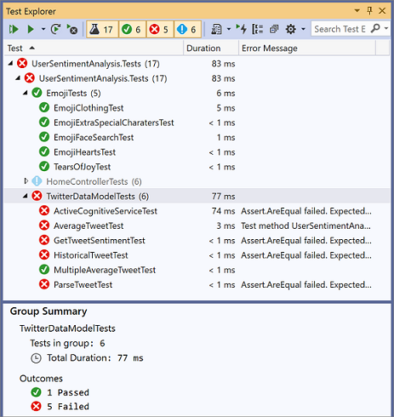
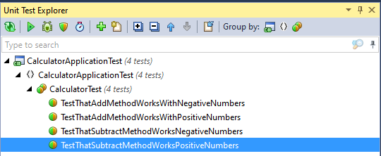
Unit testing TOOLS
Test Explorer
The Test Explorer window helps developers and testers to create, manage, and run unit tests. You can use the Microsoft unit test framework or one of several third-party and open-source frameworks.
Built in Visual studio tool ReSharper

Slide 11
Unit testing In C#
MS test. Test ATTRIBUTES
[TestClass]
Denotes a class that contains unit tests.
[TestMethod]
Indicates a method is a test method.
[TestInitialize]
This attribute is needed when we want to run a function before execution of a test.
[TestCleanup]
This attribute is like the opposite of TestInitialize, each time the function is decorated with this attribute it will execute when test execution finishes.
[ClassInitialize]
The method decorated by [ClassInitialize] is called once before running the tests of the class.
[ClassCleanup]
The method decorated by [ClassCleanup] is called after all tests from all classes are executed.
Notes:
https://docs.microsoft.com/en-us/dotnet/api/microsoft.visualstudio.testtools.unittesting?view=mstest-net-1.3.2

Slide 12
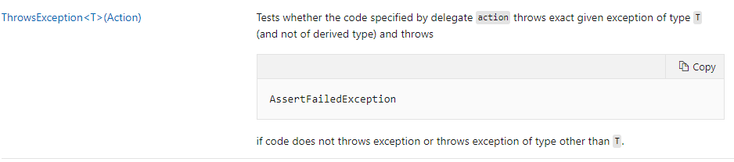
Unit testing In C#
Assert class
A unit test method exercises the code of a method in your application's code, but it reports the correctness of the code's behavior only if you include Assert statements.
Methods:

Slide 13

Unit testing In C#
SHOULDLY
Shouldly is an assertion framework which focuses on giving great error messages when the assertion fails while being simple and terse.
Link on GitHub
Notes:
Shouldly is an assertion framework which focuses on giving great error messages.
This assertion framework is test framework agnostic. That means that it can be used with any test framework.
So why should you use Shouldly?

Slide 14
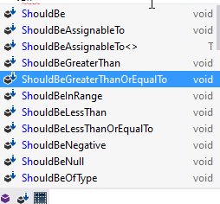
Shouldly’s Benefits
Improved test code readability
[TestMethod()]
public void AddTest() {
var result = calculator.Add(0.5, 0.5);
double expected = 1.0;
Assert.AreEqual(expected, result);
}
[TestMethod()]
public void AddTest() {
calculator.Add(0.5, 0.5).ShouldBe(1.0);
}
Notes:
First of all Shouldly improves readability of a test code. The assertions are shorter and what is more, reads in a more fluent way.
With Shouldly we are reading calculator.Add().ShouldBe();
With other assertion things get more complicated.
While writing regular assertion Visual Studio intelicence will give you a hint how to place your arguments,
with Shouldly ordering comes in a natural way. It’s not possible to pass arguments in incorrect order.
Shouldly library contains various assert helper methods. They will help you to build complex assertions.

Slide 15
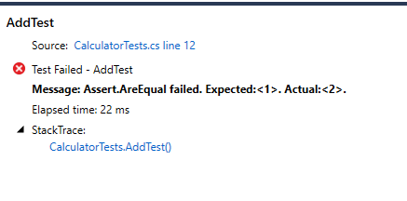
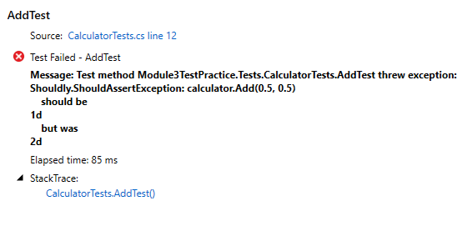
Shouldly’s Benefits
Better test failure messages
Notes:
Next advantage is that it improves failure messages.
Let's take a look at some of the tests messages that Shouldly produces and compare them to other test framework messages.
On the left we have outcome of None Shouldly Assert. Without looking at the source code its hard to tell which failure this message relates to.
The same Assert using Shouldly will provide information that its calculator.Add() method has failed.
With Shouldly we get more information about the context of the test. Shouldly have added information about:
object which was used for an action
Method called
an arguments that been passed into the method
With Shouldly you get way more contextual information about why test is failing. That make it easier to investigate failed tests.

Slide 16
Shouldly’s Benefits
Additional features
Multiple Assert Failure Reporting
Asserting Code Execution Speed
Dynamic Property Asserts
Additional Failure Message Text
Notes:
Shouldly can do more. Here is some additional features:
Multiple assert failure reporting. If a single test method has multiple asserts within it, they can be grouped. Test won’t stop its execution after first assertion
You can test on expected execution time. If test is slower than expected assert will fail
Allow to check whether dynamic object contains needed property - DynamicShould
You can specify additional failure messages

Slide 17
Shouldly’s tradeoffs
Shouldly requires a bit of extra consideration on a build machine. As explained here, part of the magic is using PDB files to help with its error messages, so things get weird if you haven’t set those up.
Shouldly, like anything else, involves taking an extra dependency in your codebase. As dependencies go, one for non-production code presents relatively little risk, but this is something you should always consider.
Notes:
Shouldly doesn't come without trade offs. It require build machine to be configured in a special way.
You can find more information in the GitHub issue’s thread.
It also involves taking extra dependency.
That isn't a big deal for nonproduction code, but still worth considering.
pdb is a program database file and it is created on compile. This file holds debugging and project state information that allows incremental linking of a debug configuration of your program.

Slide 18
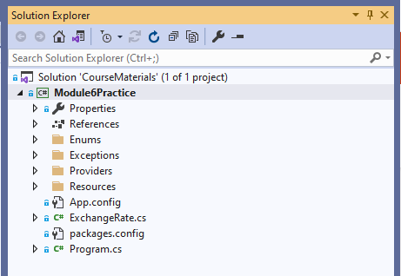
Project for hands on tasks
Preparation before the first practice
Clone the following GIT repo:
https://github.com/d-okhrimenko/CSharpForTestAutomationMaterials.git
Or make fetch/pull if you have a local copy of this repo from the previous day.
Checkout mod6_initial branch.

Slide 19

PRACTIcE 1
The FIRST UNIT TEST
Let's create a simple Calculator class and two methods - Add and Subtract.
Each method should handle two double variable types as input parameters
The result of the method should be of type double rounded by two decimal places
Do not provide any method implementation
Create a unit test project and think of possible test scenarios.
MSTest should be considered as projects unit testing framework
Your first unit tests should be based on MSTest Assert class
Create unit tests to cover not implemented methods – Add and Subtract
Check your unit tests – should fail
Provide an implementation
Check your unit tests – should pass, otherwise go to step 5

Slide 20
PRACTIcE 1
The FIRST UNIT TEST
Let’s migrate from Assert Class to Shouldly - please provide a refactoring for all the unit tests in your project.
Install Shouldly NuGet package dependency into your test project – version 3.0.2
Replace Assert invocation with Shouldly syntax.
Make sure that your tests are still working

Slide 21
PRACTIcE 1
The FIRST UNIT TEST
[TestClass]
public class CalculatorTest {
private readonly Calculator _calculator = new Calculator();
[TestMethod]
public void TestThatAddMethodWorksWithPositiveNumbers() {
double result = _calculator.Add(2.5689, 6.3896);
Assert.AreEqual(8.96, result);
}
[TestMethod]
public void TestThatAddMethodWorksWithNegativeNumbers() {
double result = _calculator.Add(-2.5689, -6.3896);
Assert.AreEqual(-8.96, result);
}
[TestMethod]
public void TestThatSubtractMethodWorksPositiveNumbers() {
double result = _calculator.Subtract(2.5689, 6.3896);
Assert.AreEqual(-3.82, result);
}
[TestMethod]
public void TestThatSubtractMethodWorksNegativeNumbers() {
double result = _calculator.Subtract(-2.5689, -6.3896);
Assert.AreEqual(3.82, result);
}
}
public class Calculator {
private const int _decimalPlaces = 2;
public double Add(double value1, double value2) {
return Math.Round(value1 + value2, _decimalPlaces);
}
public double Subtract(double value1, double value2) {
return Math.Round(value1 - value2, _decimalPlaces);
}
}

Slide 22
PRACTIcE 1
REFACTOR YOUR FIRST UNIT TEST
[TestClass]
public class CalculatorTest {
private readonly Calculator _calculator = new Calculator();
[TestMethod]
public void TestThatAddMethodWorksWithPositiveNumbers() {
_calculator.Add(2.5689, 6.3896).ShouldBe(8.96);
}
[TestMethod]
public void TestThatAddMethodWorksWithNegativeNumbers() {
_calculator.Add(-2.5689, -6.3896).ShouldBe(-8.96);
}
[TestMethod]
public void TestThatSubtractMethodWorksPositiveNumbers() {
_calculator.Subtract(2.5689, 6.3896).ShouldBe(-3.82);
}
[TestMethod]
public void TestThatSubtractMethodWorksNegativeNumbers() {
_calculator.Subtract(-2.5689, -6.3896).ShouldBe(3.82);
}
}

Slide 23

Coffee time

Slide 24
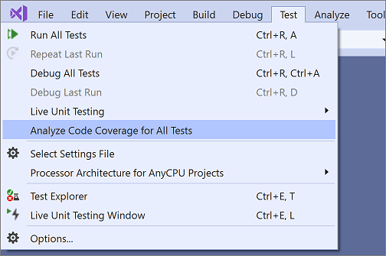
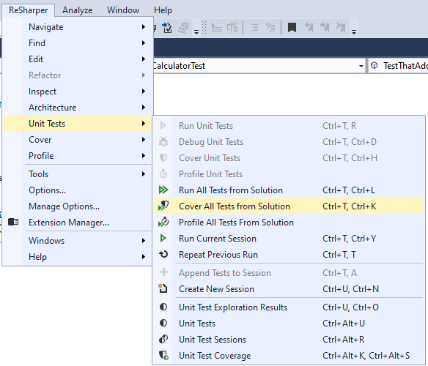
Unit testing TOOLS
code coverage
To determine what proportion of your project's code is being tested by coded tests such as unit tests, you can use the code coverage feature of Visual Studio.
Built in Visual studio tool ReSharper
Notes:
To determine what proportion of your project's code is being tested by coded tests, you can use the code coverage feature of Visual Studio.
Code coverage is an option when you run test methods using Test Explorer.
Note : The code coverage feature is available only in Visual Studio Enterprise edition.
As an alternative you can use ReSharper. It includes dotCover which is a test runner and code coverage tool.

Slide 25
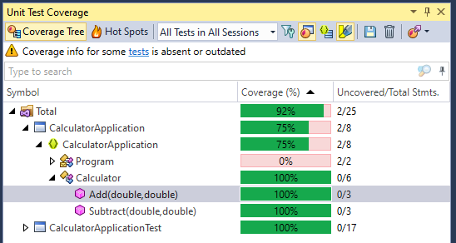
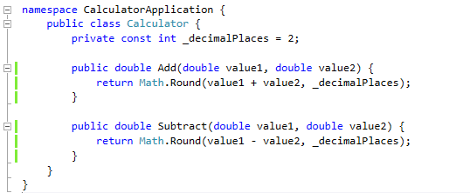
Unit testing TOOLS
code coverage
ReSharper
Notes:
The Unit Test Coverage window shows the percentage of the code that was run in each assembly, class, and method.
In addition, it gives you an advantage of visualizing code coverage in code editor window. The source editor shows you which code line has been executed.
dotCover can figure out on-the-fly which unit tests are affected by your latest code changes, and automatically re-runs the affected tests for you.
The continuous testing mode can be switched on for any unit test session: this way you can choose which tests you want to run continuously and which to run the traditional way.
Continuous testing mode can be turned on in settings.

Slide 26
PRACTIcE 2
CURRENCY CONVERTER
Let’s implement the new method in calculator class:
public double ConvertToCurrency(double amount, DateTime exchangeDate, Currencies targetCurrency)
New method should convert USD currency to another one at specific date. The result should be rounded by two decimal places.
You should be able to handle only - USD-USD and USD-EUR conversions (enum type – Currencies)
Please use ExchangeRatesProvider to retrieve the rates.
(fetched internally from comma-separated file: \Module5Practice.CalculatorApplication\Resources\ExchangeRates.csv)
Notes:
3 slides with practice – 45 min

Slide 27
PRACTIcE 2
CURRENCY CONVERTER
Check the code coverage for your solution. ConvertToCurrency() should not be covered with tests now.
Cover the method with tests. Check the code coverage again. Explore content of the csv file to pick up a date and rate combination.
Mark your new tests with a category - "CurrencyExchange". Open ReSharper’s test explorer and group by your tests by category.
Create two separate sessions – one for old tests (Add and Subtract methods) and another one for ConvertCurrency method
Configure the first unit test session (Add and Subtract methods) to run at build, try to break Add or Subtract method and rebuild the project, do you see the failed tests?

Slide 28
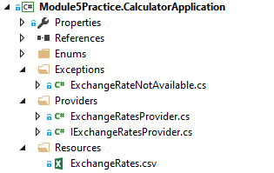
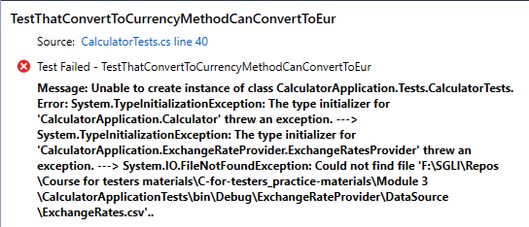
Practice 2
External dependency
Some of your tests are using ExchangeRates.csv to retrieve FX rates. Simulate unavailability of exchange rates provider by deleting the file.
Run your tests. Your tests should be failing now.

Slide 29
PRACTIcE 2
CURRENCY CONVERTER
public class Calculator {
private const int _decimalPlaces = 2;
private readonly ExchangeRatesProvider _exchangeRatesProvider = new ExchangeRatesProvider();
public double Add(double value1, double value2) {
return Math.Round(value1 + value2, _decimalPlaces);
}
public double Subtract(double value1, double value2) {
return Math.Round(value1 - value2, _decimalPlaces);
}
public double ConvertToCurrency(double amount, DateTime exchDateTime, Currencies targetCurrencies) {
if (targetCurrencies == Currencies.USD) {
return amount;
}
double rate = _exchangeRatesProvider.GetExchangeRate(targetCurrencies, exchDateTime);
return Math.Round(rate * amount, _decimalPlaces);
}
}

Slide 30
Practice 2
CURRENCY CONVERTER
[TestClass]
public class CalculatorTests {
// … other calculator tests
[TestCategory("CurrencyExchange")]
[TestMethod]
public void TestThatConvertToCurrencyMethodCanConvertToEur() {
_calculator.ConvertToCurrency(1000, new DateTime(2018, 01, 10), Currencies.EUR)
.ShouldBe(1358.34);
}
[TestCategory("CurrencyExchange")]
[TestMethod]
public void TestThatConvertToCurrencyMethodCanConvertToUsd() {
_calculator.ConvertToCurrency(1000, new DateTime(2018, 01, 10), Currencies.USD)
.ShouldBe(1000);
}
}

Slide 31
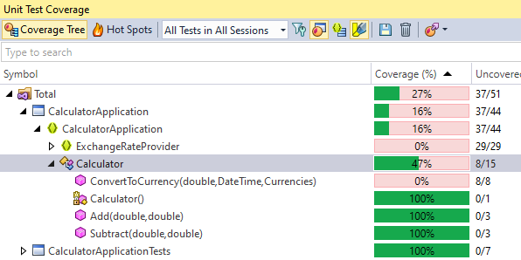
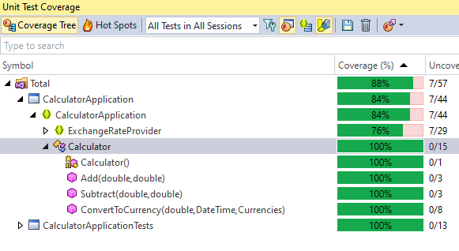
Practice 2
Code coverage

Slide 32
Coffee time

Slide 33
Dependency injection
External dependency
An external dependency is an object in your system that your code under test interacts with and over which you have no control. (Common examples are filesystems, threads, memory, time, and so on.)
namespace CalculatorApplication {
public class Calculator {
private const int _decimals = 2;
private readonly ExchangeRatesProvider _exchangeRatesProvider = new ExchangeRatesProvider();
public double Add(double value1, double value2) { … }
public double Subtract(double value1, double value2) { … }
public double ConvertToCurrency(double amount, DateTime exchDateTime, Currencies targetCurrencies) { … }
}
}
Notes:
In software engineering, dependency injection is a technique in which an object receives other objects that it depends on. These other objects are called dependencies. In the typical "using" relationship the receiving object is called a client and the passed (that is, "injected") object is called a service.
The code that passes the service to the client can be many kinds of things and is called the injector. Instead of the client specifying which service it will use, the injector tells the client what service to use. The "injection" refers to the passing of a dependency (a service) into the object (a client) that would use it.
Passing the service to the client, rather than allowing a client to build or find the service, is the fundamental requirement of the pattern.
The intent behind dependency injection is to achieve separation of concerns of construction and use of objects. This can increase readability and code reuse.

Slide 34
Dependency injection
DI implementation
Extract an interface for a known dependency (ExchangeRatesProvider and IExchangeRatesProvider
public interface IExchangeRatesProvider {
double GetExchangeRate(Currencies currency, DateTime exchangeDate);
}
internal class ExchangeRatesProvider : IExchangeRatesProvider { … }

Slide 35
Dependency injection
DI implementation
Refactor your code so it would be possible to inject an implementation of interface
Inject interface at the constructor level (association):
public class Calculator {
  private IExchangeRatesProvider _exchangeRatesProvider;
  public Calculator(IExchangeRatesProvider exchangeRatesProvider) {
    _exchangeRatesProvider = exchangeRatesProvider;
  }
}
Or inject interface at the method level (dependency):
public double ConvertToCurrency(IExchangeRatesProvider exchangeRatesProvider,
double amount, DateTime exchDateTime, Currencies targetCurrencies) { … }

Slide 36
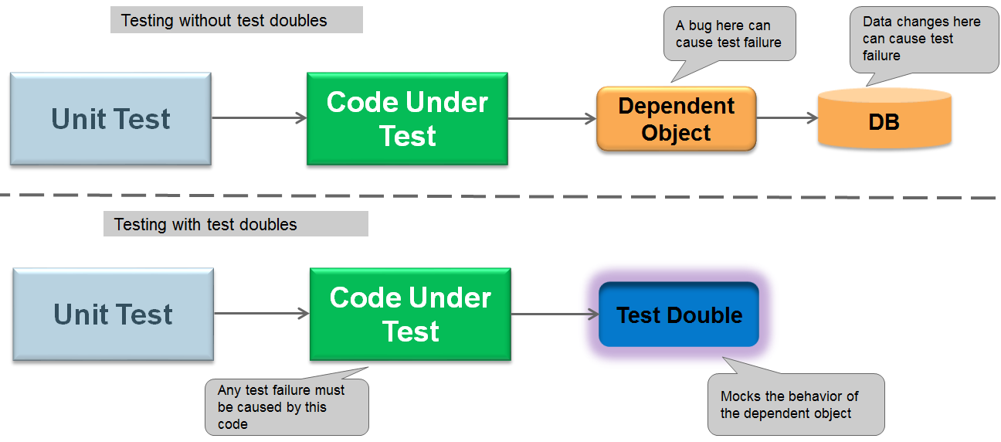
Test Doubles
DEFINITION
A test double is an object that can stand in for a real object in a test, like how a stunt double stands in for an actor in a movie.
Notes:
DI provides a lot of benefits to your code.
One of the main benefits is a fact that your code becomes more (unit) testable.
If DI is implemented in your project, you can easily replace real dependencies with their simplified copies that fulfill your test needs.
Such copies called test doubles.
Test doubles isolate your tests from external dependencies.
External dependencies are any objects in your system that your code under test interacts with and over which you have no control. (Common examples are file systems, db, memory, time, and so on.)
Programmers also like to use term mocks, when referring to the test doubles, which is not entirely correct as you will see later.
But before we will have a look on the types of test doubles, let’s have consider the benefits provided by them
So, why do we need to use test doubles?
Improves test execution speed
Responses are unpredictable. Eliminate non-deterministic dependencies. So, having fixed, expected responses makes testing easier
The real object is difficult or expensive to work with. A simpler version will serve test purposes as well. It also reduces the test complexity.
Tests should have only one reason to be failed, and it should be the code under the test. Improves test predictability/reliability
The tests should be independent from the environment where they are running, and it should be possible to rerun them several times and get the same behavior.
So, mastering Test Doubles techniques is very important to write good unit tests. Let's have a close look on their types.

Slide 37
Test Doubles
TYPES
We might use an object to stand in place of a real object in various cases, and here we will cover the 4 most used cases:
Test Doubles
Dummy Object
Fake Object
Spying Stub
Fake
Different classifications
Stub
Value-based testing
State-based testing
Mock
Interaction testing
Stub
Mock
controllable replacement for an existing dependency
just to keep your test working
can't make test to fail
Can be pre-programmed with expectations
verifiable
can make test to fail (asserted against)
Source: The Art of Unit Testing, Roy Osherove
Notes:
Probably you have heard different terms such as mocks, stubs, dummies, fake object when people are referring to the test doubles.
Let's have a look on their main characteristics
A Dummy object is the simplest one
The Dummy objects are passed around but never actually used. Usually, they are just used to fill parameter lists.
Stub is just a controllable replacement for an existing dependency (or collaborator) in the system. Provides answers to calls
By using a stub, you can test your code without dealing with the dependency directly.
A mock object is a fake object in the system that decides whether the unit test has passed or failed. It does so by verifying whether the object under test called the fake object as expected.
So, it allows to make a verification of the interaction between the thing we are testing and the dependency. Mocks may or may not provide features of stubs.
There’s usually no more than one mock per test.
A fake denotes an object that looks like another object but can be used as a mock or a stub.
Fakes contains working implementation, which of cause is not suitable for production usage (e.g. in-memory database)
There are different classifications of the test doubles which you can find in the different resources on the internet and programming books.
For example, you can come across term spy that represents test double which collects and stores information about its usage.
In this course we mainly follow classification from “Art of Unit Testing” book by Roy Osherove.
According to this classification we have two main types of test doubles: the stubs and the mocks.
The term “Fake object” we will mostly use as a generic name for a any test double, and not as a separate type of test doubles.

Slide 38
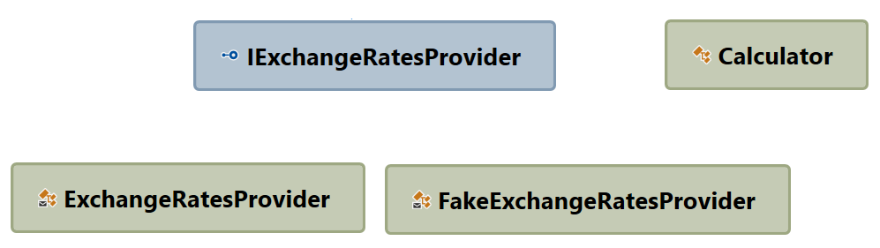

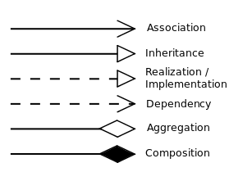

TEST DOUBLES
STUBS
Stub is a Fake object that holds predefined data and uses it to answer calls during tests.
    A stub is a controllable replacement for an existing dependency (or collaborator) in the system.
    By using a stub, you can test your code without dealing with the dependency directly.
In this example, Calculator class has external dependency on ExchangeRatesProvider which is a great candidate to be replaced with Fake object.
Notes:
In programming, you use stubs to get around the problem of external dependencies.
A stub is a controllable replacement for an existing dependency (or collaborator) in the system.
By using a stub, you can test your code without dealing with the dependency directly.
The easiest way to tell you’re dealing with a stub is to notice that the stub can never fail the test.
The asserts that the test uses are always against the class under test.

Slide 39
PRACTIcE 3
CURRENCY CONVERTER TEST – STUB IMPLEMENTATION
Let’s implement the new test for ConvertToCurrency method in Calculator class which will check that result is always rounded to 2 decimal places.
Consider FakeExchangeRatesProvider to remove external dependency.
Make a refactoring of Calculator class for IExchangeRatesProvider dependency injection through constructor
FakeExchangeRatesProvider should implement IExchangeRatesProvider
FakeExchangeRatesProvider results should follow requirements:
  If currency is USD, then 1.0 should be returned as output in regardless of input date
  If currency is not USD, then the hardcoded value 1.5 should be returned.
Update existing test methods and add new ones to verify the following:
Currency conversion is correct and corresponds to the fx-rates hardcoded in the stub;
The result is always rounded to two decimals (check cases with different currencies).
Update the Calculator class itself if some scenario from pervious step are failed.

Slide 40
PRACTIcE 3
CURRENCY CONVERTER TEST – STUB IMPLEMENTATION
internal class FakeExchangeRatesProvider : IExchangeRatesProvider {
public double StubFxRate { get; set; } = 1.5;
public double GetExchangeRate(Currencies currency, DateTime exchangeDate) {
return currency == Currencies.USD ? 1 : StubFxRate;
}
}
public double ConvertToCurrency(double amount, DateTime exchDateTime, Currencies targetCurrencies) {
double rate = targetCurrencies == Currencies.USD ? 1 : _exchangeRatesProvider.GetExchangeRate(targetCurrencies, exchDateTime);
return Math.Round(rate * amount, _decimalPlaces);
}
[TestCategory("CurrencyExchange")]
[TestMethod]
public void TestThatConvertToCurrencyMethodCanConvertToEur() {
_calculator.ConvertToCurrency(1000.001, new DateTime(2018, 01, 10), Currencies.EUR)
.ShouldBe(1500);
}
[TestCategory("CurrencyExchange")]
[TestMethod]
public void TestThatConvertToCurrencyMethodCanRoundResultForUsd() {
_calculator.ConvertToCurrency(1000.001, new DateTime(2018, 01, 10), Currencies.USD)
.ShouldBe(1000);
}

Slide 41

LUNCH

Slide 42
Test Doubles
interaction based testing. MOCKS
Mocks are fake objects that register calls they receive and based on this info decide whether the test has passed or failed.
Key characteristics of the mocks
A mock object can make a test fail
Can be used in cases where other types of test doubles aren't applicable
One mock object per test
Notes:
Well, as I stated earlier, there are two main types of test doubles we are considering: stubs and mocks.
These two types of test doubles correspond to the two approaches of unit testing:
Value or stated based testing. When you run a unit of work and then check a value being returned or state of the system directly
In the interaction testing you run the code and checks that it has interacted with other parts of the system or external dependencies correctly.
The tests we were writing before can be classified as value-based tests. As the name implies in these tests the result (a value) is being checked.
Value-based testing checks the value returned from a function. State-based testing is about checking for noticeable behavior changes in the system under test, after changing its state.
Interaction testing is different, it allows to test how an object communicates (calls methods) to other objects.
Usually, interaction testing is used when calling another object itself is the end result of a specific unit of work.
As an example of such interaction can be using an email service, logger service, insert/update operations against data-repository.
A mock object is a fake object in the system that decides whether the unit test has passed or failed.
It does so by verifying whether the object under test called the fake object as expected. There’s usually no more than one mock per test.
In a test where you test only one thing (which is how I recommend you write tests), there should be no more than one mock object.
All other fake objects will act as stubs. Having more than one mock per test usually means you’re testing more than one thing, and this can lead to complicated or brittle tests.
Always worth to consider interaction testing only as the last option. This is very important. It’s preferable to see if you can use the value or state based approach of end result
tests of units of work, because so many things become much more complicated by having interaction tests, as you’ll see in this chapter.
But sometimes, as is the case of a third-party call to a logger, interactions between objects are the end result. That’s when you need to test the interaction itself.

Slide 43
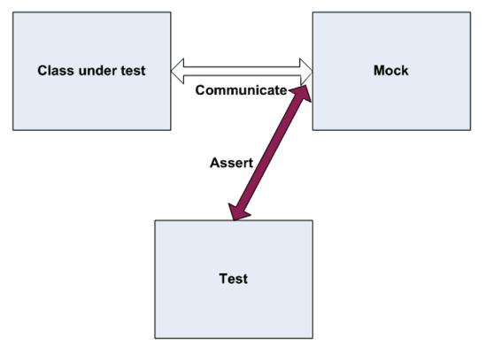
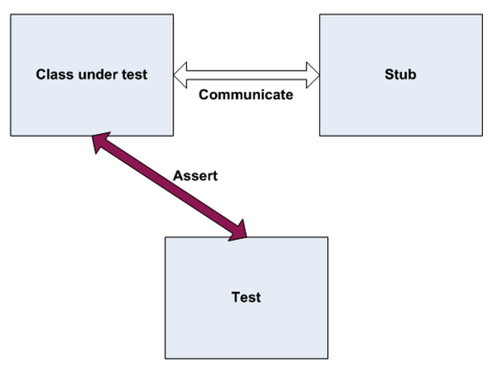
Test Doubles
MOCKS VS STUBS
The basic difference is that stubs can’t fail tests, but Mocks - can.
Notes:
At first glance, the difference between mocks and stubs may seem small or even nonexistent.
The basic difference is that stubs can’t fail tests. Mocks can.
What does it mean?
In a test that uses mocks you write an assert statement against the mock itself.
In the test with stubs you always make an assert against the tested class or component
The easiest way to tell that you’re dealing with a stub is to notice that the stub can never
fail the test. The asserts that the test uses are always against the class under test.
Small demo with handwriten mock example

Slide 44
Test Doubles
SIMPLE Mock example. DEmo
public double ConvertToCurrency(double amount, DateTime exchangeDate, Currencies targetCurrency) {
if (Currencies.USD == targetCurrency) {
return Math.Round(amount,DECIMALS_NUMBER);
}
var rate = _exchangeRatesProvider.GetExchangeRate(targetCurrency, exchangeDate);
return Math.Round(amount*rate, DECIMALS_NUMBER);
}
[TestMethod]
public void TestThatExchangeProviderShouldNotCalledForUsd (){
var exchangeMock = new ExchangeProviderCustomMock();
Calculator calculator=new Calculator(exchangeMock);
calculator.ConvertToCurrency(100.123, new DateTime(2020, 1, 1), Currencies.USD);
calculator.ConvertToCurrency(110.123, new DateTime(2020, 2, 1), Currencies.USD);
exchangeMock.VerifyCalls(Currencies.USD, 0);
calculator.ConvertToCurrency(100, new DateTime(2020, 1, 1), Currencies.EUR);
exchangeMock.VerifyCalls(new DateTime(2020, 1, 1), Currencies.EUR, 1);
}
public class ExchangeProviderCustomMock : IExchangeRatesProvider {
private readonly List<ExhangeRateArgument> _callData = new List<ExhangeRateArgument>();
public double GetExchangeRate(Currencies currency, DateTime exchangeDate) {
_callData.Add(new ExhangeRateArgument(currency, exchangeDate));
return Double.MinValue;
}
public void VerifyCalls(DateTime date, Currencies currency, int expectedNumberOfCalls) {
var actualNumberOfCalls = _callData.FindAll(
arg => arg.ExchnageDate == date && arg.Currency == currency).Count;
Assert.AreEqual(expectedNumberOfCalls, actualNumberOfCalls);
}
public void VerifyCalls(DateTime date, int expectedNumberOfCalls) {
var actualNumberOfCalls = _callData.FindAll(arg =>
arg.ExchnageDate == date).Count;
Assert.AreEqual(expectedNumberOfCalls, actualNumberOfCalls);
}
public void VerifyCalls(Currencies currency, int expectedNumberOfCalls) {
var actualNumberOfCalls = _callData.FindAll(
arg => arg.Currency == currency).Count;
Assert.AreEqual(expectedNumberOfCalls, actualNumberOfCalls);
}
}
internal class ExhangeRateArgument {
public ExhangeRateArgument(Currencies currency, DateTime exchnageDate) {
Currency = currency;
ExchnageDate = exchnageDate;
}
public Currencies Currency { get; }
public DateTime ExchnageDate { get; }
}

Slide 45

Test Doubles
isolation frameworks. MOQ
An isolation framework is a set of programmable APIs that makes creating of fake objects much simpler, faster, and shorter than hand-coding them.
Moq is the most popular and friendly mocking library for .NET
Link on GitHub
Notes:
Probably during the last demo and the previous practice you’ve got an impression that writing your own implementation of test doubles is a cumbersome task.
So, there are a lot of different isolation frameworks available on the market today which significantly reduce effort on unit testing.
Isolation frameworks, when designed well, can save the developer from the need to write repetitive code to assert or simulate object interactions, and
if they’re designed very well, they can make tests last many years without making the developer come back to fix them on every little production code change.
There are plenty of isolation frameworks available on the market today. We will have a look on Moq as the most popular one for .Net world.
When we create mock objects using moq, we can use them as Dummies, stubs or Mocks
And for the most cases when we use Moq we don't need to worry about distinguishing between dummies, stubs and mocks.
Actually, it is the main idea of the Moq design, to be simple and practical to use
Design goals of Moq are
- simple
- practical
- easy to use
- strongly typed
- open source
As the authors stated, the one of the main advantages is low learning curve, that doesn't include studying documentation at all.

Slide 46
PRACTIcE 4
CURRENCY CONVERTER TEST – MOCK IMPLEMENTATION
Let’s implement new test for ConvertToCurrency method based on ExchangeRatesProvider mock.
ExchangeRatesProviderMock should be implemented by using NuGet dependency - Moq
ExchangeRatesProviderMock should be trained once before all test's execution, to return the specific set of data:
  2000/1/1 – 0.75 (EUR)
  2000/1/2 – 0.81 (EUR)
  2000/1/3 – 0.79 (EUR)
  2000/1/4 – 0.82 (EUR)
  2000/1/5 – 0.89 (EUR)
  Any date – 1 (USD)
  This should be done in ClassInitialize.
Test the result for USD currency at 2000/1/1 and 2000/1/2
Test the result for EUR currency at 2000/1/1, 2000/1/2 and 2000/1/3
Using Moq functionality verify that method GetExchangeRate is called 2 times for USD currency, 3 times for EUR currency and 1 time for any currency at 2000/1/3
Check the final test coverage of your solution.
Update your test with TestCleanup method to reset invocations history for mock object after each test execution

Slide 47
PRACTIcE 4
CURRENCY CONVERTER TEST – mock IMPLEMENTATION
private static readonly Mock<IExchangeRatesProvider> _exchangeRatesProviderMock = new Mock<IExchangeRatesProvider>();
[ClassInitialize]
public static void ClassInitializer(TestContext context) {
_exchangeRatesProviderMock.Setup(provider => provider.GetExchangeRate(Currencies.EUR, new DateTime(2000, 1, 1)))
.Returns(0.75);
_exchangeRatesProviderMock.Setup(provider => provider.GetExchangeRate(Currencies.EUR, new DateTime(2000, 1, 2)))
.Returns(0.81);
_exchangeRatesProviderMock.Setup(provider => provider.GetExchangeRate(Currencies.EUR, new DateTime(2000, 1, 3)))
.Returns(0.79);
_exchangeRatesProviderMock.Setup(provider => provider.GetExchangeRate(Currencies.EUR, new DateTime(2000, 1, 4)))
.Returns(0.82);
_exchangeRatesProviderMock.Setup(provider => provider.GetExchangeRate(Currencies.EUR, new DateTime(2000, 1, 5)))
.Returns(0.89);
_exchangeRatesProviderMock.Setup(provider => provider.GetExchangeRate(Currencies.USD, It.IsAny<DateTime>()))
.Returns(1);
}
[TestCleanup]
public void TestCleanup() {
_exchangeRatesProviderMock.Invocations.Clear();
}
[TestCategory("CurrencyExchange")]
[TestMethod]
public void TestThatCurrencyExchangeWorksMock() {
var calculator = new Calculator(_exchangeRatesProviderMock.Object);
calculator.ConvertToCurrency(1000, new DateTime(2000, 1, 1), Currencies.EUR).ShouldBe(750);
calculator.ConvertToCurrency(1000, new DateTime(2000, 1, 2), Currencies.EUR).ShouldBe(810);
calculator.ConvertToCurrency(1000, new DateTime(2000, 1, 3), Currencies.EUR).ShouldBe(790);
calculator.ConvertToCurrency(1000, new DateTime(2000, 1, 1), Currencies.USD).ShouldBe(1000);
calculator.ConvertToCurrency(1000, new DateTime(2000, 1, 2), Currencies.USD).ShouldBe(1000);
_exchangeRatesProviderMock.Verify(provider => provider.GetExchangeRate(Currencies.USD, It.IsAny<DateTime>()),
Times.Exactly(0));
_exchangeRatesProviderMock.Verify(provider => provider.GetExchangeRate(Currencies.EUR, It.IsAny<DateTime>()),
Times.Exactly(3));
_exchangeRatesProviderMock.Verify(provider => provider.GetExchangeRate(It.IsAny<Currencies>(), new DateTime(2000, 1, 3)),
Times.Exactly(1));
}

Slide 48
Homework

